Slide 1
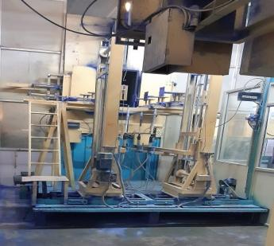
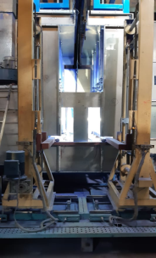
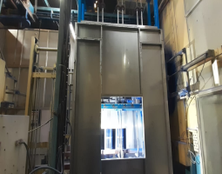
Kaizen
Dept./Section : Powder Coating
Process : Powder Coating
Date of implementation : 06-04-2021
Improvement categories (Tick the applicable one’s) :
(1) Quality imp.
(2) Manpower/Man hours
(3) Reduce 3M
(4) Space saving
(5) Time saving
(6) Energy Saving
(7) Tact
(8) Yield
(9) 5S
(10) Efficiency
(11) Material Saving
(12) Waste Reduction
(13) Packing
(14) Safety
(15) Others
Before
After
Without Booth
Booth Install
Benefits:
1- Quality improve
2- Powder saving
3- Increase safety

Slide 2
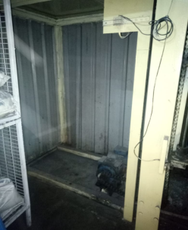
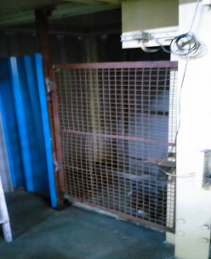
Kaizen
Dept./Section : Powder Coating
Process : Powder Coating
Date of implementation : 12-03-2021
Improvement categories (Tick the applicable one’s) :
(1) Quality imp.
(2) Manpower/Man hours
(3) Reduce 3M
(4) Space saving
(5) Time saving
(6) Energy Saving
(7) Tact
(8) Yield
(9) 5S
(10) Efficiency
(11) Material Saving
(12) Waste Reduction
(13) Packing
(14) Safety
(15) Others
Before
After
Not door/Cover
Door Install
Benefits:
1- Reduce Accidental Chances

Slide 3
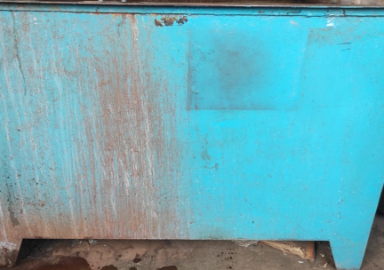
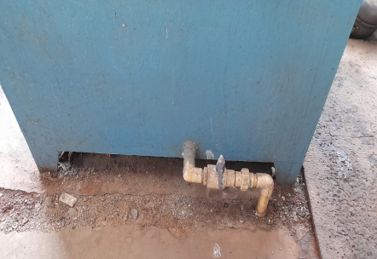
Kaizen
Dept./Section : Leakage testing
Process : Tank Leakage Testing
Date of implementation : 15-03-2021
Improvement categories (Tick the applicable one’s) :
(1) Quality imp.
(2) Manpower/Man hours
(3) Reduce 3M
(4) Space saving
(5) Time saving
(6) Energy Saving
(7) Tact
(8) Yield
(9) 5S
(10) Efficiency
(11) Material Saving
(12) Waste Reduction
(13) Packing
(14) Safety
(15) Others
Before
After
Manual water Draining system
Pipe install to water draining
Benefits:
1- Reduce manpower for tank clean
2- 5S improves
3- Quality improve because tank timely clean

